Slide 1
Project Title: RED-LINE MARKUPS OF IMO RIVER AS-BUILT #12485
Charter Template
Business Case/Objectives:
There has been several facility modifications that have occurred over the years in Imo River.
These changes are required to be reflected on the facility As-built drawings. But due to the high financial cost of having the SEDO team carrying out update of the drawings, Imo river asset team intend to carry out DIY red-line mark ups of these drawings.
Potential Benefits & Measurement:
Correctness of facility drawings
Increased personnel understanding of station layout
Improve process safety
Project Scope/Actions :
List out and print out all facility drawings
Draw up schedule for each discipline to carry out mark up
Execution of site verification and mark-ups by each discipline
Technical authority approval of red-marked drawings
Critical Success Factors:
Asset leader support
Support from Technical authorities
Asset personnel support
Project Sponsor: Oladimeji Bashorun
Implementation Lead: Benjamin Obong
Project Team: David Vincent, Uzorho Charles, Aboaba Eniola, Salami Tayo, Mohammed Musa, Okpako Ogba, Salisu Hassan, Udo Uzochukwu, Nwabueze Sunday
High-level Timeline:
L0-L1: July 2018
L2: July 2018
L3: August 2018
L4: September 2018
L5: October 2018
Initiative End

Slide 2
Weekly cadence commitment template
No. | Action | Action Party | Threat | Due Date | Status
1-1.1 | List out and print out all facility drawings | DCC |  | 31/07/18
1-1.2 | Draw up schedule for each discipline to carry out mark up | DCC |  | 31/07/18
1-1.3 | Execution of site verification and mark-ups by each discipline | Discipline leads |  | 30/09/18
1-1.4 | Technical authority approval of red-marked drawings | TAs |  | 31/10/18
1-1.9

Slide 3
Weekly cadence commitment template past 7 days
No. | Action | Action Party | Threat | Due Date | Status
10-4.1 |  |  |  |  | New
10-4.2 |  |  |  |  | New
10-4.3
10-4.4
10-4.5
10-4.6
10-4.7
10-4.8
10-4.9
10-4.10
10-4.11
10-4.12
10-4.13
10-4.14
10-4.15
10-4.16

Slide 4
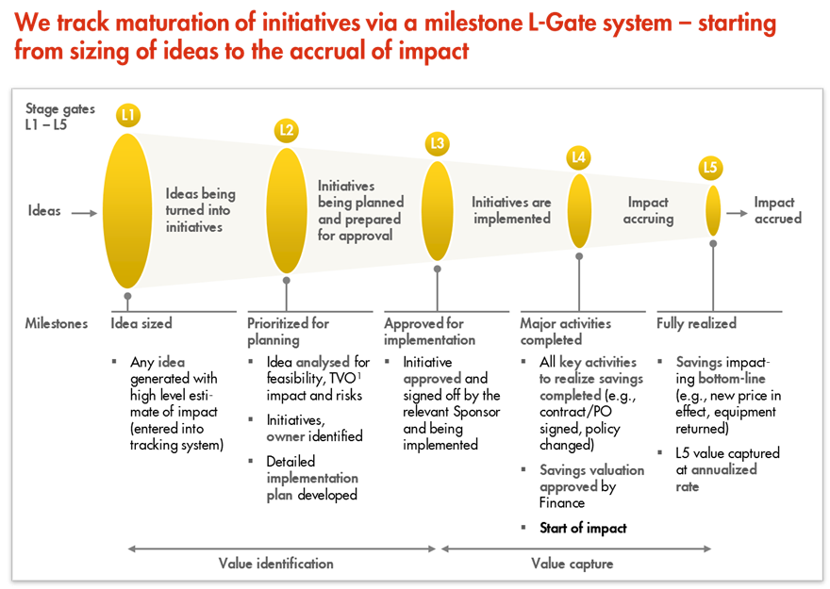
L1 – L5 Gates

